Slide 1
Past, Present, and Future
Psychogenic Seizures:
S. Marc Testa, Ph.D.
March 15, 2013

Slide 2
Objectives
1
2
3
Timeline:
“Hysteria”
Where to?
Current concepts: psychogenic seizures

Slide 3
But first…

Slide 4
What are psychogenic non-epileptic “seizures”?
Seizure-like episode
Movement
Sensation
Experience
No epileptiform activity
Emotional cause assumed
Notes:
- Most common semiology: excessive movement
- Less common: stiffening and tremor
- Consciousness appears impaired

Slide 5
Common & Costly
Annual Incidence:
1.4 per 100,000 (an underestimate?)
Prevalence
2-33 per 100,000
Annual costs:
$110 million to $4 billion (Martin, 1998)
Notes:
-

Slide 6
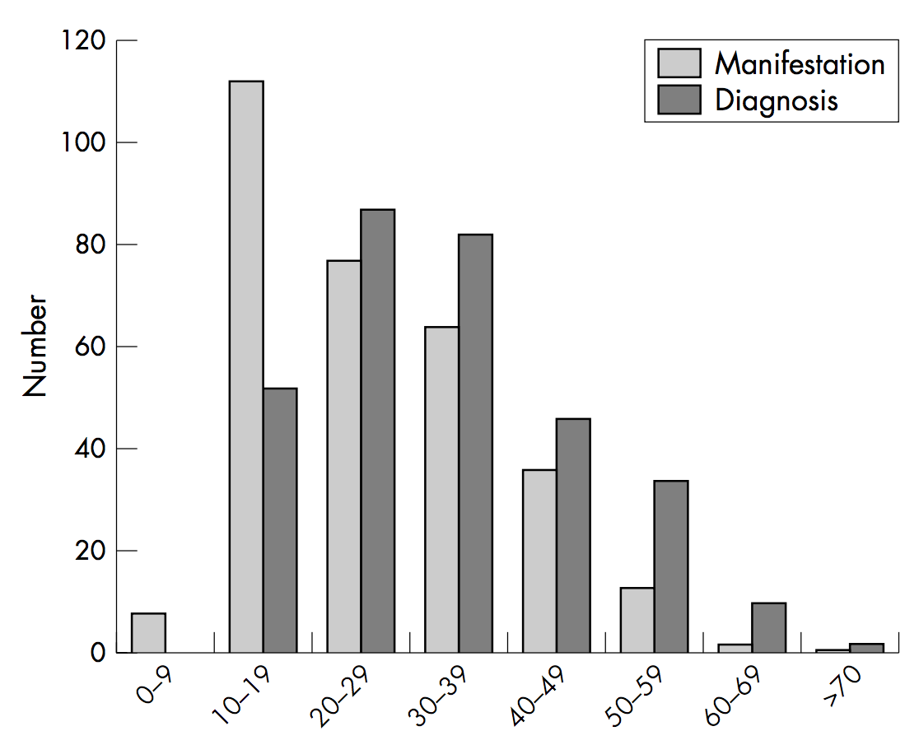
Avg. diagnostic delay = 7.2 years
N=313, Reuber, 2002

Slide 7
in the meantime...
Unnecessary treatment
multiple antiepileptic drugs w/ serious side effects.
Emergency room visits may result in invasive and hazardous treatment.
Patients are often of child bearing age
Anti-epileptics can have adverse impact on the developing fetus.
Notes:
- 164 patients
- 12 years after manifestation
- 4 years after diagnosis
- 71.2% continued to have seizures
- 56.4% were dependent on social security.
- Outcome better with:
- higher education
- younger onset and diagnosis
- less dramatic attacks
- fewer somatoform complaints
- lower scores
- dissocation
- “inhibitedness”
- “emotional dysregulation”
- “compulsivity”

Slide 8
Longterm…
After a mean of 11 years following manifestation and 4 years after diagnosis:
66% of PNES patients still have seizures
>50% are occupationally disabled
41.4% on health grounds
12.4% unemployed
Mean age 38.6 years

Slide 9
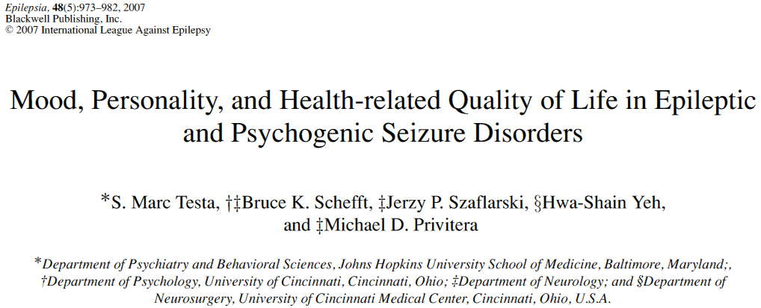
Diminished QoL
Notes:
DISSERTATION
QoL correlates…
as potential treatment targets

Slide 10
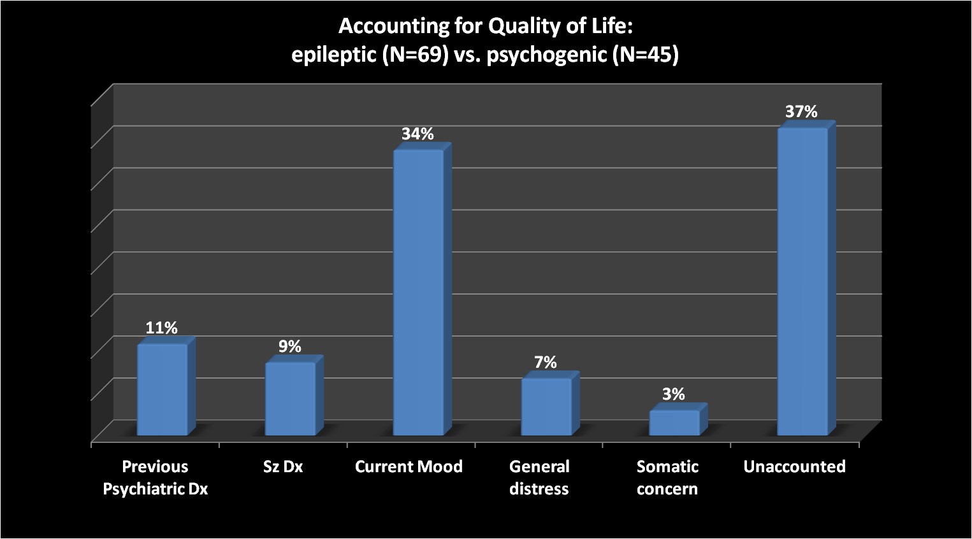
Notes:
MOOD
DISTRESS
SOMATIC FOCUS

Slide 11
1
Timeline
“Hysteria”
Notes:
SO HOW HAVE THESE BEHAVIORS BEEN
VIEWED THROUGHOUT HISTORY??

Slide 12
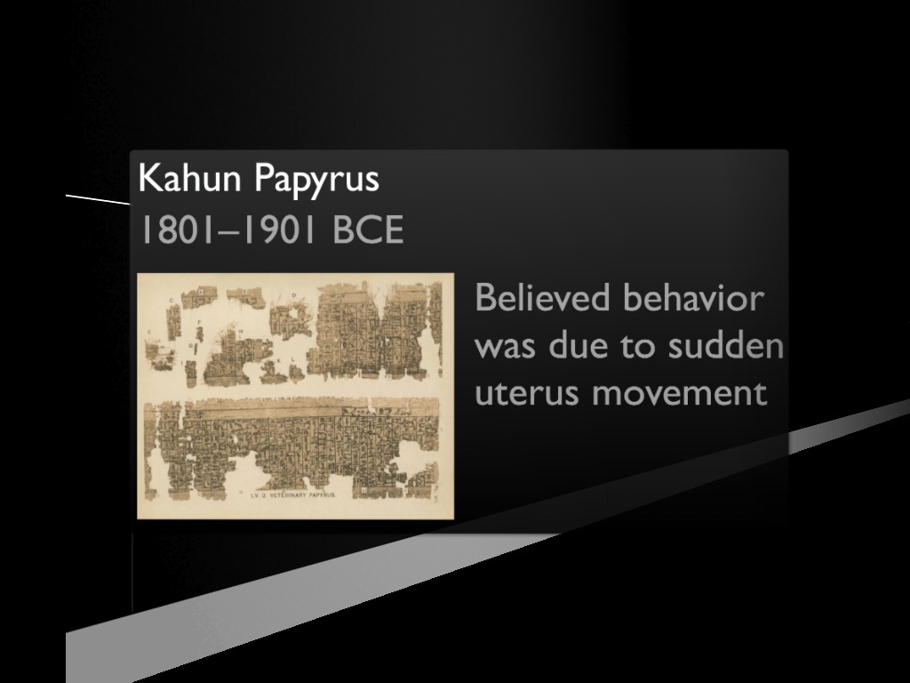
Notes:
documents mention:
Symptoms: pain
Cause: “starvation” of the uterus
Treatment: physical

Slide 13
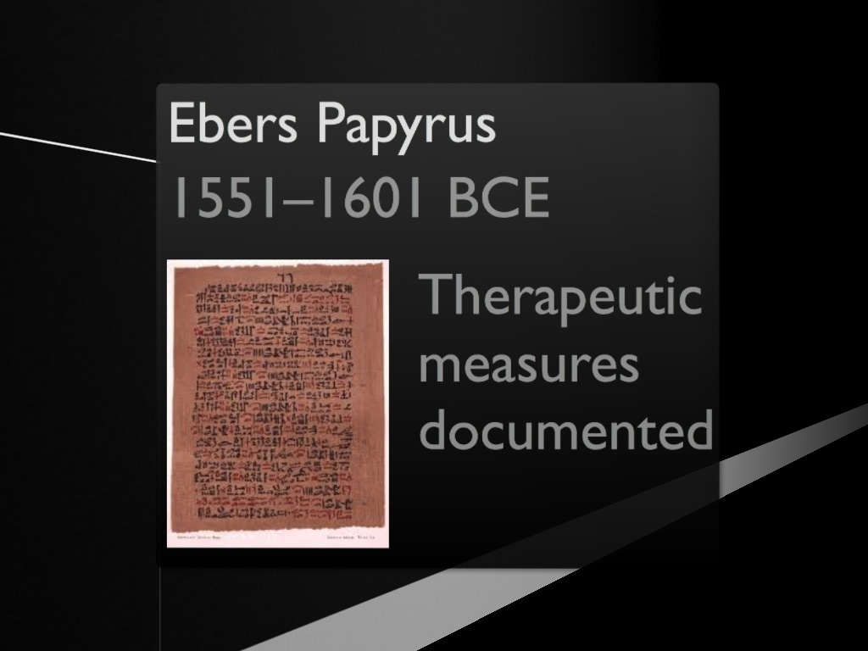
Notes:
- More documentation of therapeutic measures

Slide 14
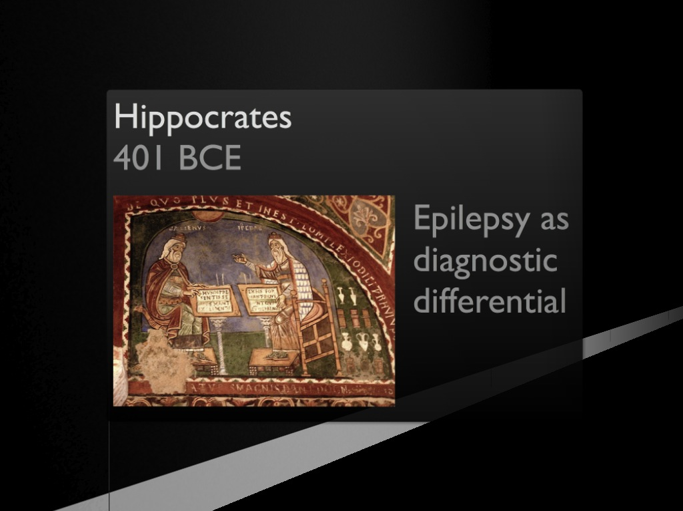
Notes:
• Expanded uterine theory
• OF NOTE:
- differentiated epilepsy from psychogenic seizures
- applying digital pressure to the abdomen
- if patient perceived…likely hysteria.
• 2300 years later Charcot modified the technique

Slide 15
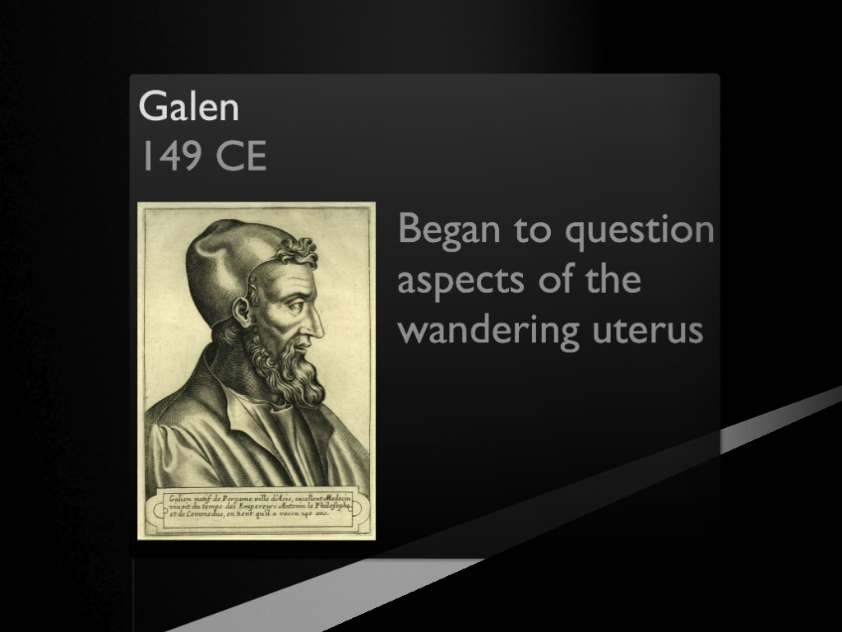
Notes:
- most accomplished of all medical researchers of antiquity
- THOUGH he diagnosed hysterical suffocation....
- did not believe in movement of the uterus......
- Based on DISSECTION…tried to persuade colleagues proposal was erroneous

Slide 16

Notes:
No pathological evidence for uterine abnormality
BUT…strong tradition to follow ancient authority vs. drawing conclusions from clinicopathological correlates.
Renaissance
Saw advances in understanding anatomy
This may have moved the focus to the nervous system

Slide 17

Notes:
BUT…also witchcraft.
Despite this….Edward Jorden FOCUSED ON THE IDEA THAT THIS WAS MEDICALLY EXPLAINED
- 1602 Famous case: Mary Glover/Elizabeth Jackson
- 3 medical experts...
- 2 = behavior was from being bewitched.
- 1 (Jorden) = saw this as behavior that has been described historically.
Judge decided in favor of the 2 experts.

Slide 18
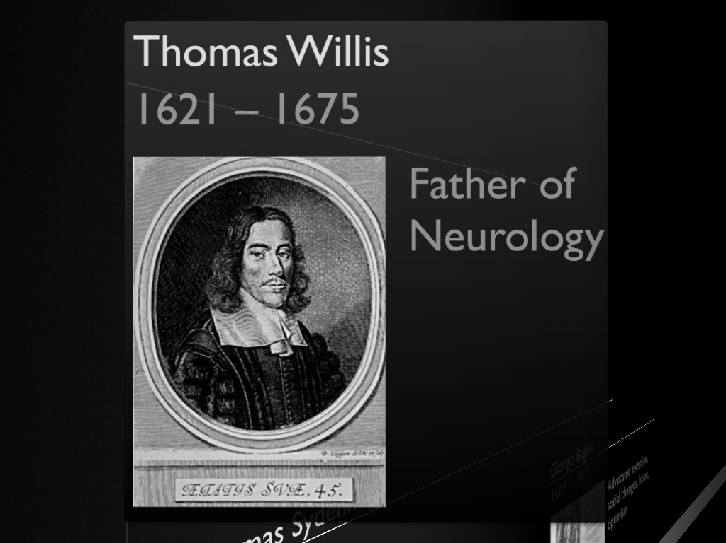
Notes:
1st to attribute hysteria to brain
“As we have shown before the passions vulgarly called hysterical do not always proceed from the womb, but often from the head’s being affected”
• NOT from uterus or spleen
• TREATMENT: Willis advocated hitting such patients with a stick.

Slide 19
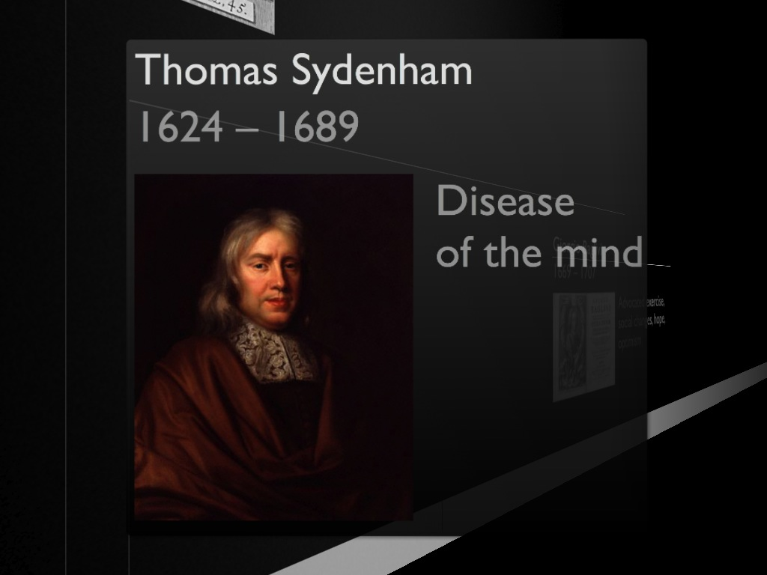
Notes:
studied hysteria because “next to fever, it was the most common of diseases”
By NOW psych factors = etiology
A “disease of the mind.”
HYPOCHONDRIASIS = men
HYSTERIA = women
TREATMENT
• physical treatments to purify/fortify blood
• encouraged regular exercise
• emphasized personal interest in the patient’s welfare.

Slide 20

Notes:
early 18th century = chair of medical theory at:
Collegio della Sapienza in Rome,
treatment:
- exercise
- change of social circumstances
encouraged physicians to:
- enquire about patient’s mental state
- instill hope and optimism

Slide 21
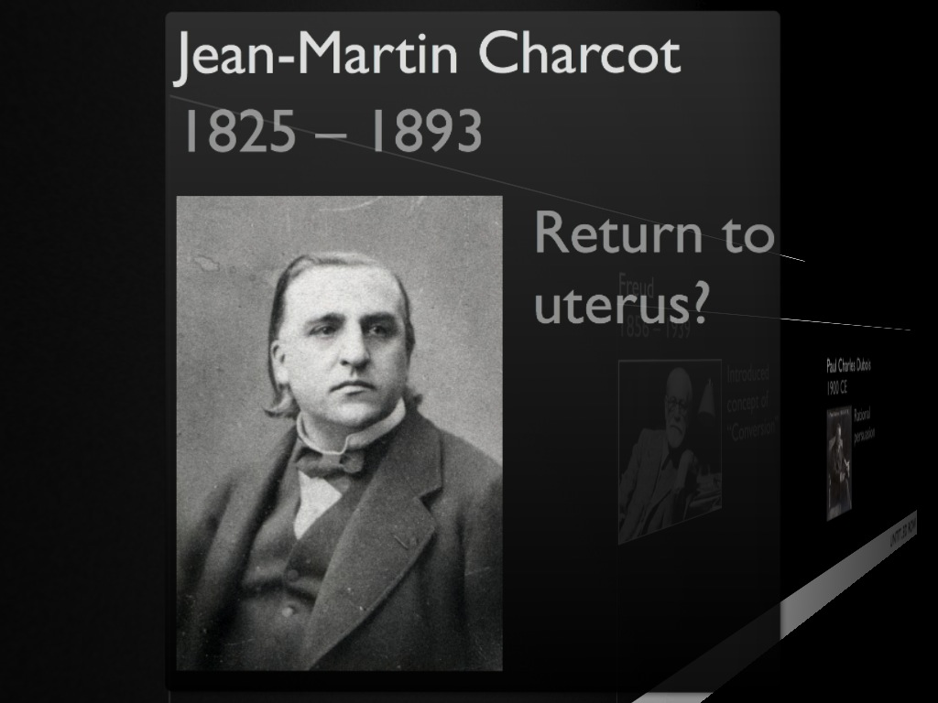
Notes:
Sort of….used ovarian compression belt for tx.
But..
argued against widespread prejudice that hysteria was rarely found in men.
"cases often went unrecognized, even by distinguished doctors"
Occurs in models of masculinity like railway engineers or soldiers. OIF/OEF
• Charcot pioneered tenet that hysteria’s lesion was both organic (in ‘‘higher cortical centers”) and psychologic.
• The organic lesion was neither circumscribed nor de- structive, but “dynamic” or functional
Charcot, writing about hysteria in 1889, said:
“There is without doubt a lesion of the nervous centres but where is it situated and what is its nature? . . . Certainly it is not of the nature of a circumscribed organic lesion of a destructive nature . . . one of those lesions which escape our present means of anatomical investigation, and which for want of a better term, we designate dynamic or functional lesion”.

Slide 22
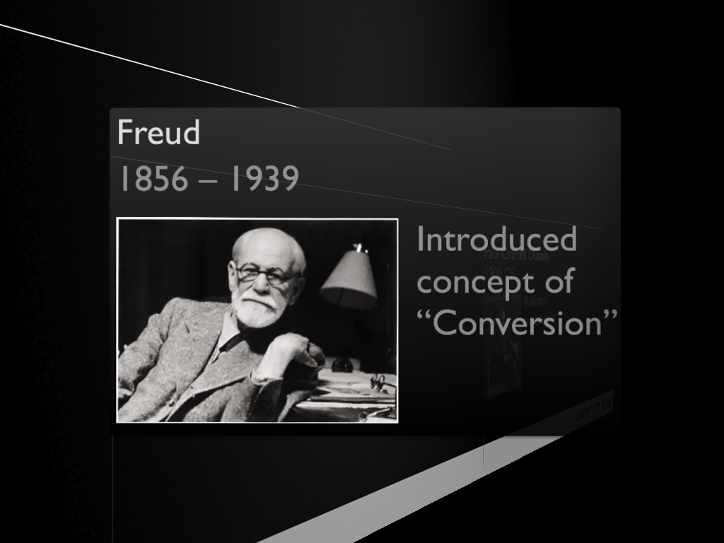
Notes:
“CONVERSION”
- The idea that psychological symptoms are “converted” into physical symptoms.
- This may have overshadowed other, more reasoned approaches.
EXAMPLE: Robert Brundenell Carter
Just before Freud.
Thought unexplained symptoms were reversible functional disturbance of the nervous system
TREATMENT:
attention to psychological aspects of medical management.
other physicians of this age held the view that psychological aspects of treatment were important
Dx. had to be delivered in a way that was congruent with the patients’ somatic view of their illness.

Slide 23
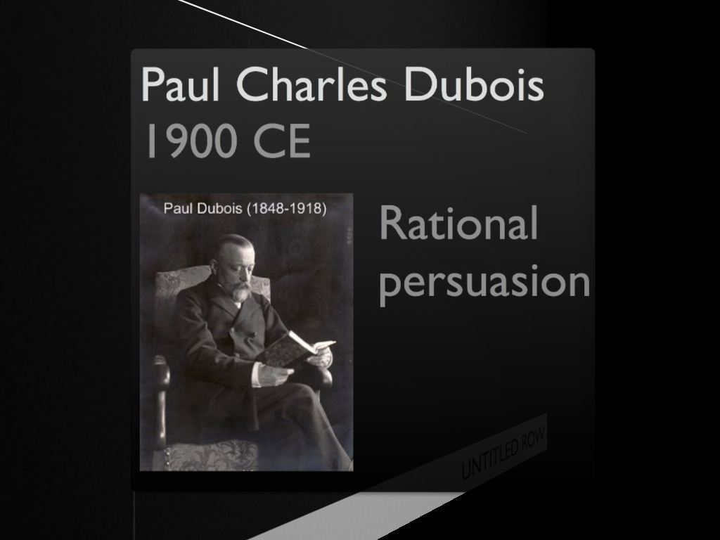
Notes:
Swiss Physician
- Approach to such functional nervous disorders as “rational persuasion” :
a psychotherapy delivered within a medical context
- PRINCIPLES:
1. obtain the patient’s confidence
2. demonstrate sympathy w/ patient’s experience
3. listen to the patient’s history without impatience
4. use medical authority and the therapeutic relationship to convey to patients the belief that they would recover
5. Build collaborative relationship
6. Treatment should be explained to family members

Slide 24
2
Current concepts: psychogenic seizures

Slide 25

Are we less confused in 2013 CE than1800 BCE?
Notes:
How do we classify these unexplained symptoms?

Slide 26
Classification
ICD-10
DSM-IV
DSM-V
Anxiety, dissociative and somatoform disorders
Functional Neurological Disorder
Somatoform
Notes:
DSM-V
Drop conversion?
No requirement for associated psychological factors
- Very difficult to establish
- research suggests psychological factors may have a weak association
- what is dissociative?

Slide 27
Description?
Abnormal
behavior ?
Psychological features
& Life story
& environment influences
Notes:
As a psychologist…
I am more concerned with:
Understanding and describing how symptoms developed and are maintained
This is likely to be more clinically useful than classification

Slide 28
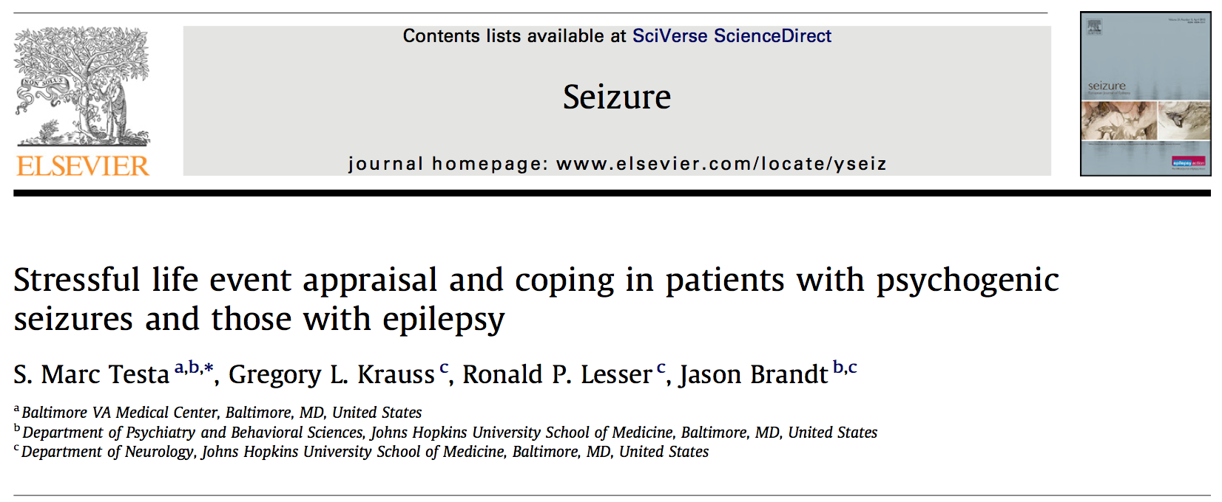
EMU Sample
Epilepsy: N = 20
Psychogenic: N = 40
*Neurologically healthy: N = 40
*Estimated IQ & education

Slide 29
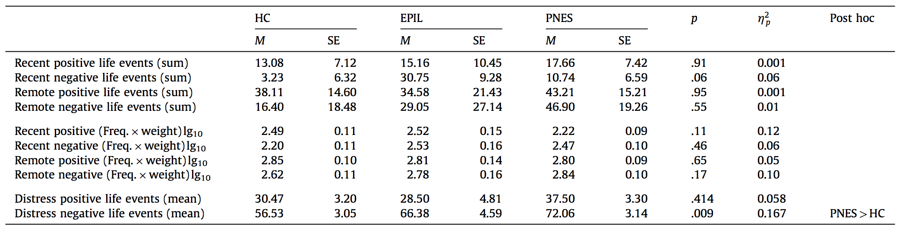
Stressful life events
Notes:
Positive & negative,
Recent, remote & distress
no DIFFS…ONLY large effect for:
Negative life event distress ratings

Slide 30
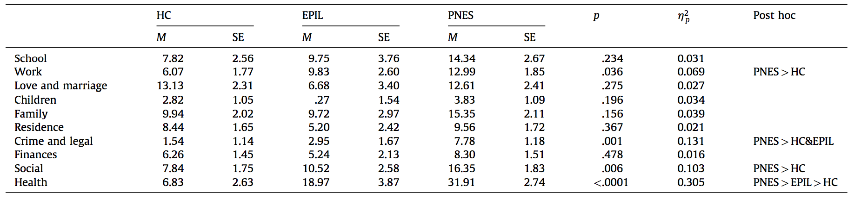
Distress ratings by life domain
Notes:
Domains of:
Work
Crime and legal
Social functioning
health

Slide 31
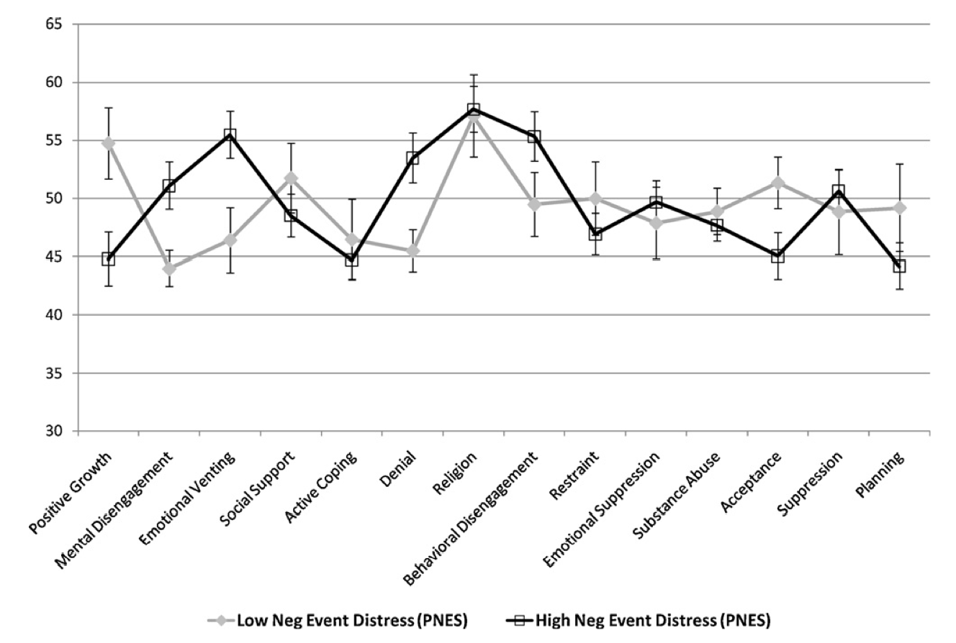
Notes:
Coping in PNES:
- Diminished active coping & planning
More negative life event distress:
More Denial
diminished positive growth.
The relationship between coping and perceived distress suggests that greater distress related to negative life events is associated with increased use of denial in PNES patients.

Slide 32
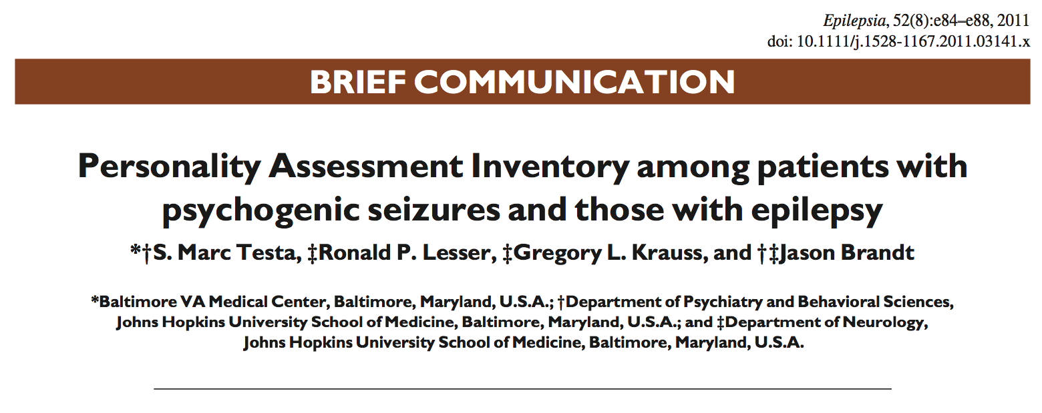
EMU Sample
Epilepsy: N = 55
Psychogenic: N = 62
Neurologically healthy: N = 45
Notes:
How about psychological symptoms?

Slide 33
Notes:
Very somatically focused
High levels of depressive symptoms….but what type?

Slide 34
Notes:
High ‘conversion’ – more unexplained physcial symptoms
For anxiety and depressive symptoms
Higher physical than affective or cognitive

Slide 35
3
Where
to?

Slide 36
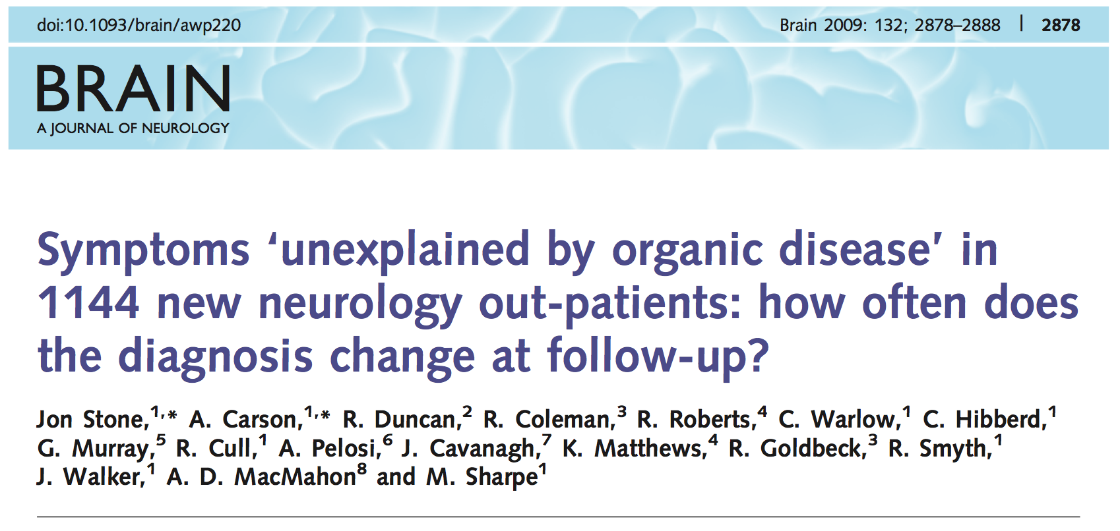
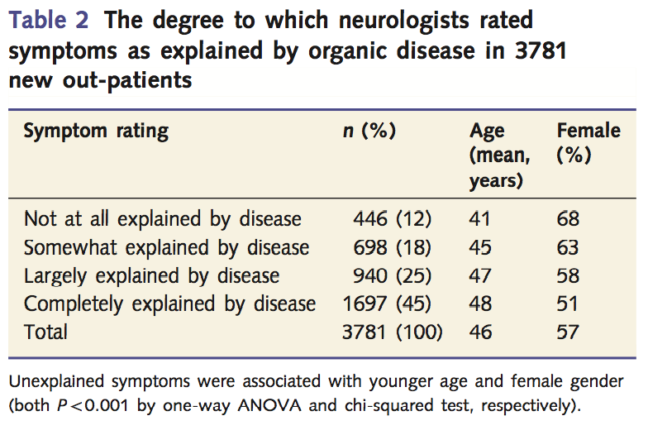
Notes:
30% n=1144

Slide 37
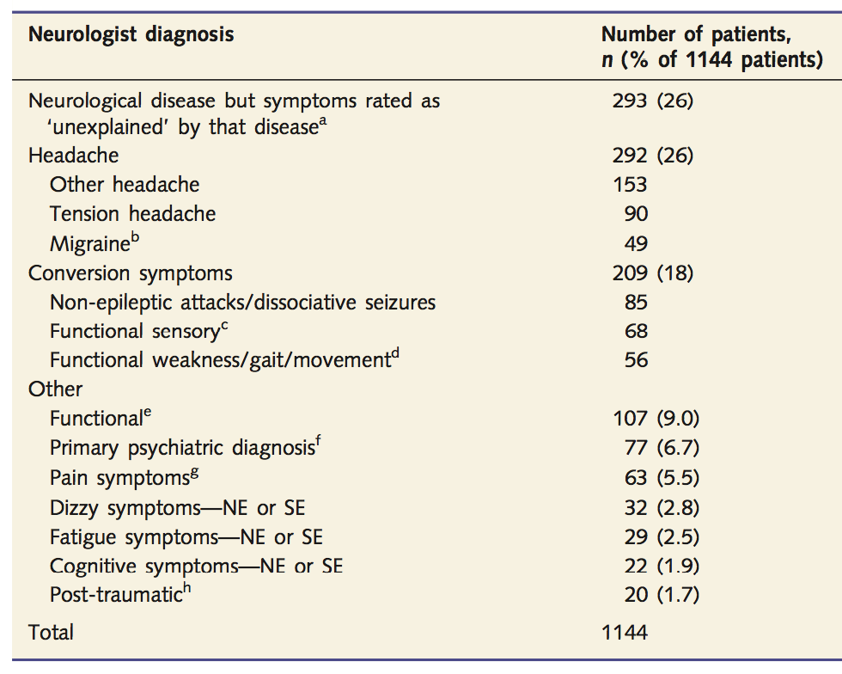
Notes:
26% have a neurologic condition
18% conversion

Slide 38
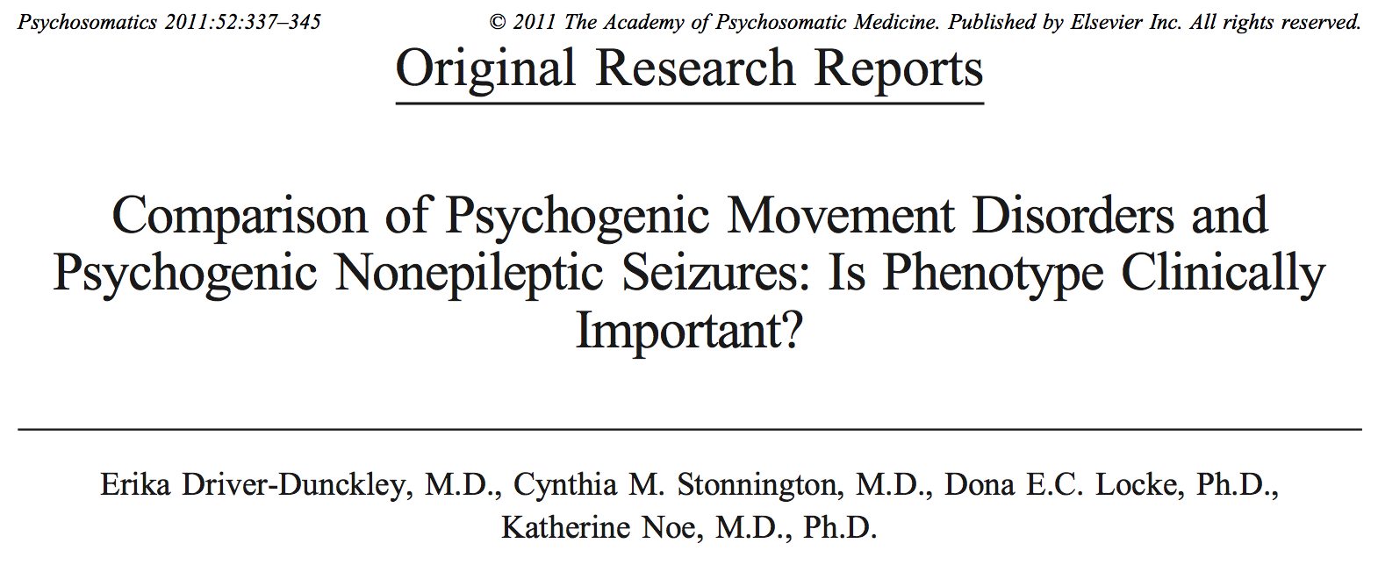
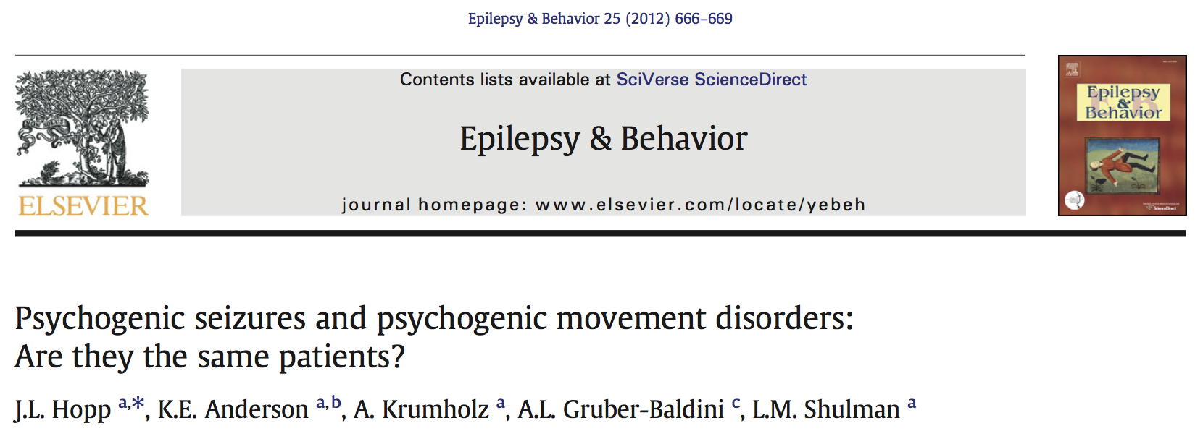
Notes:
I think this is just the beginning and with so many patient displaying these problems….a good approach to identification and treatment is needed.

Slide 39
Acknowledgements
EMU Attendings
Gregory Bergey, M.D.
Nathan Crone, M.D.
Eileen Vining, M.D.
Support and Guidance
Jason Brandt, Ph.D.
Gregory L. Krauss, M.D.
Ronald Lesser, M.D.
Research Assistants
Jung Geum Im, M.A.
Sarini Ettigi , M.A.
Shaina Fieldstone, B.A.
Epilepsy Fellows
Mackenzie Cervenka, M.D.
Susan Shaw, M.D.

